Slide 1

Object-oriented design models using uml
Objective 3:

Slide 2
Design Models Artefacts
Design model involves an elaboration of the analysis model where we add detail and specific technical solutions
The design model contains the same sorts of things as the analysis model, but all the artefacts are more fully formed and must now include implementation details
E.g. An analysis class may be little more than a sketch with few attributes and only key operations (or just a domain model)
A design class, however, must be fully specified – all attributes and operations (including return types and parameter lists) must be complete

Slide 3
Design Models: UML Diagrams
Design subsystems ➔ Package Diagram
Design classes ➔ Class Diagram also known as Design Class Diagram
Interfaces ➔ Component Diagram (as discussed in Module 6: Architectural Design)
Use case realizations ➔ Sequence Diagram also known as Design Sequence Diagram (and its relation to Design Class Diagram)
Deployment diagram (implementation)

Slide 4
Design Models (our focus)
Design subsystems ➔ Package Diagram
Design classes ➔ Class Diagram
Interfaces (already discussed in Module 6)
Use case realizations ➔ Sequence Diagram
Deployment diagram (implementation)

Slide 5
Object-Oriented Design Models
Identify all objects that must work together to carry out a use case
Package diagrams denote which classes work together as a subsystem
Divide objects into groups for a multilayer design
Sequence diagrams describe the messages that are sent between objects
Design class diagrams document and describe the programming classes (implementation)
Design information is primarily derived from domain model and sequence diagram from the analysis stage

Slide 6
Design subsystemS: package diagram
Design subsystems ➔ Package Diagram
Design classes ➔ Class Diagram
Use case realizations ➔ Sequence Diagram
Deployment diagram (implementation)

Slide 7
Package Diagram: Structuring the Major Components
Associates classes of related groups or related use case
One option is to separate the view, domain, and data access layers into separate packages
Indicate dependency relationships:
  Shows which elements affect other elements in a system
  May exist between packages, or between classes within packages
Packages can be nested

Slide 8
Multilayer Design
Focus on a basic multilayer design that consists of the view layer realization of use cases specification of all detailed system processing for:
  User interface classes
  Domain layer (problem domain classes from the domain model class diagram), controller classes
  Data layer (database access classes)

Slide 9
Heuristics to Identify Subsystem
Assign objects identified in one use case into the same subsystem
Minimize the number of associations crossing subsystem boundaries
All objects in the same subsystem must be functionally related
Source: Bennett et al. (2010)

Slide 10
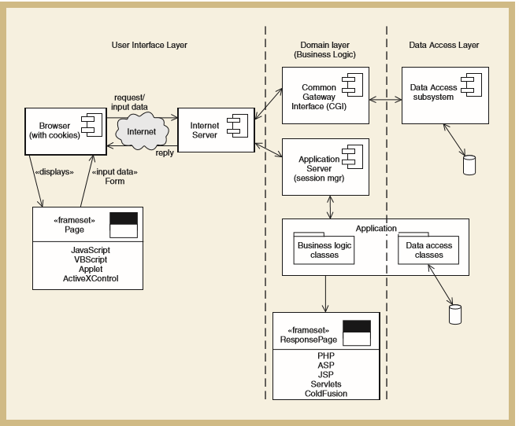
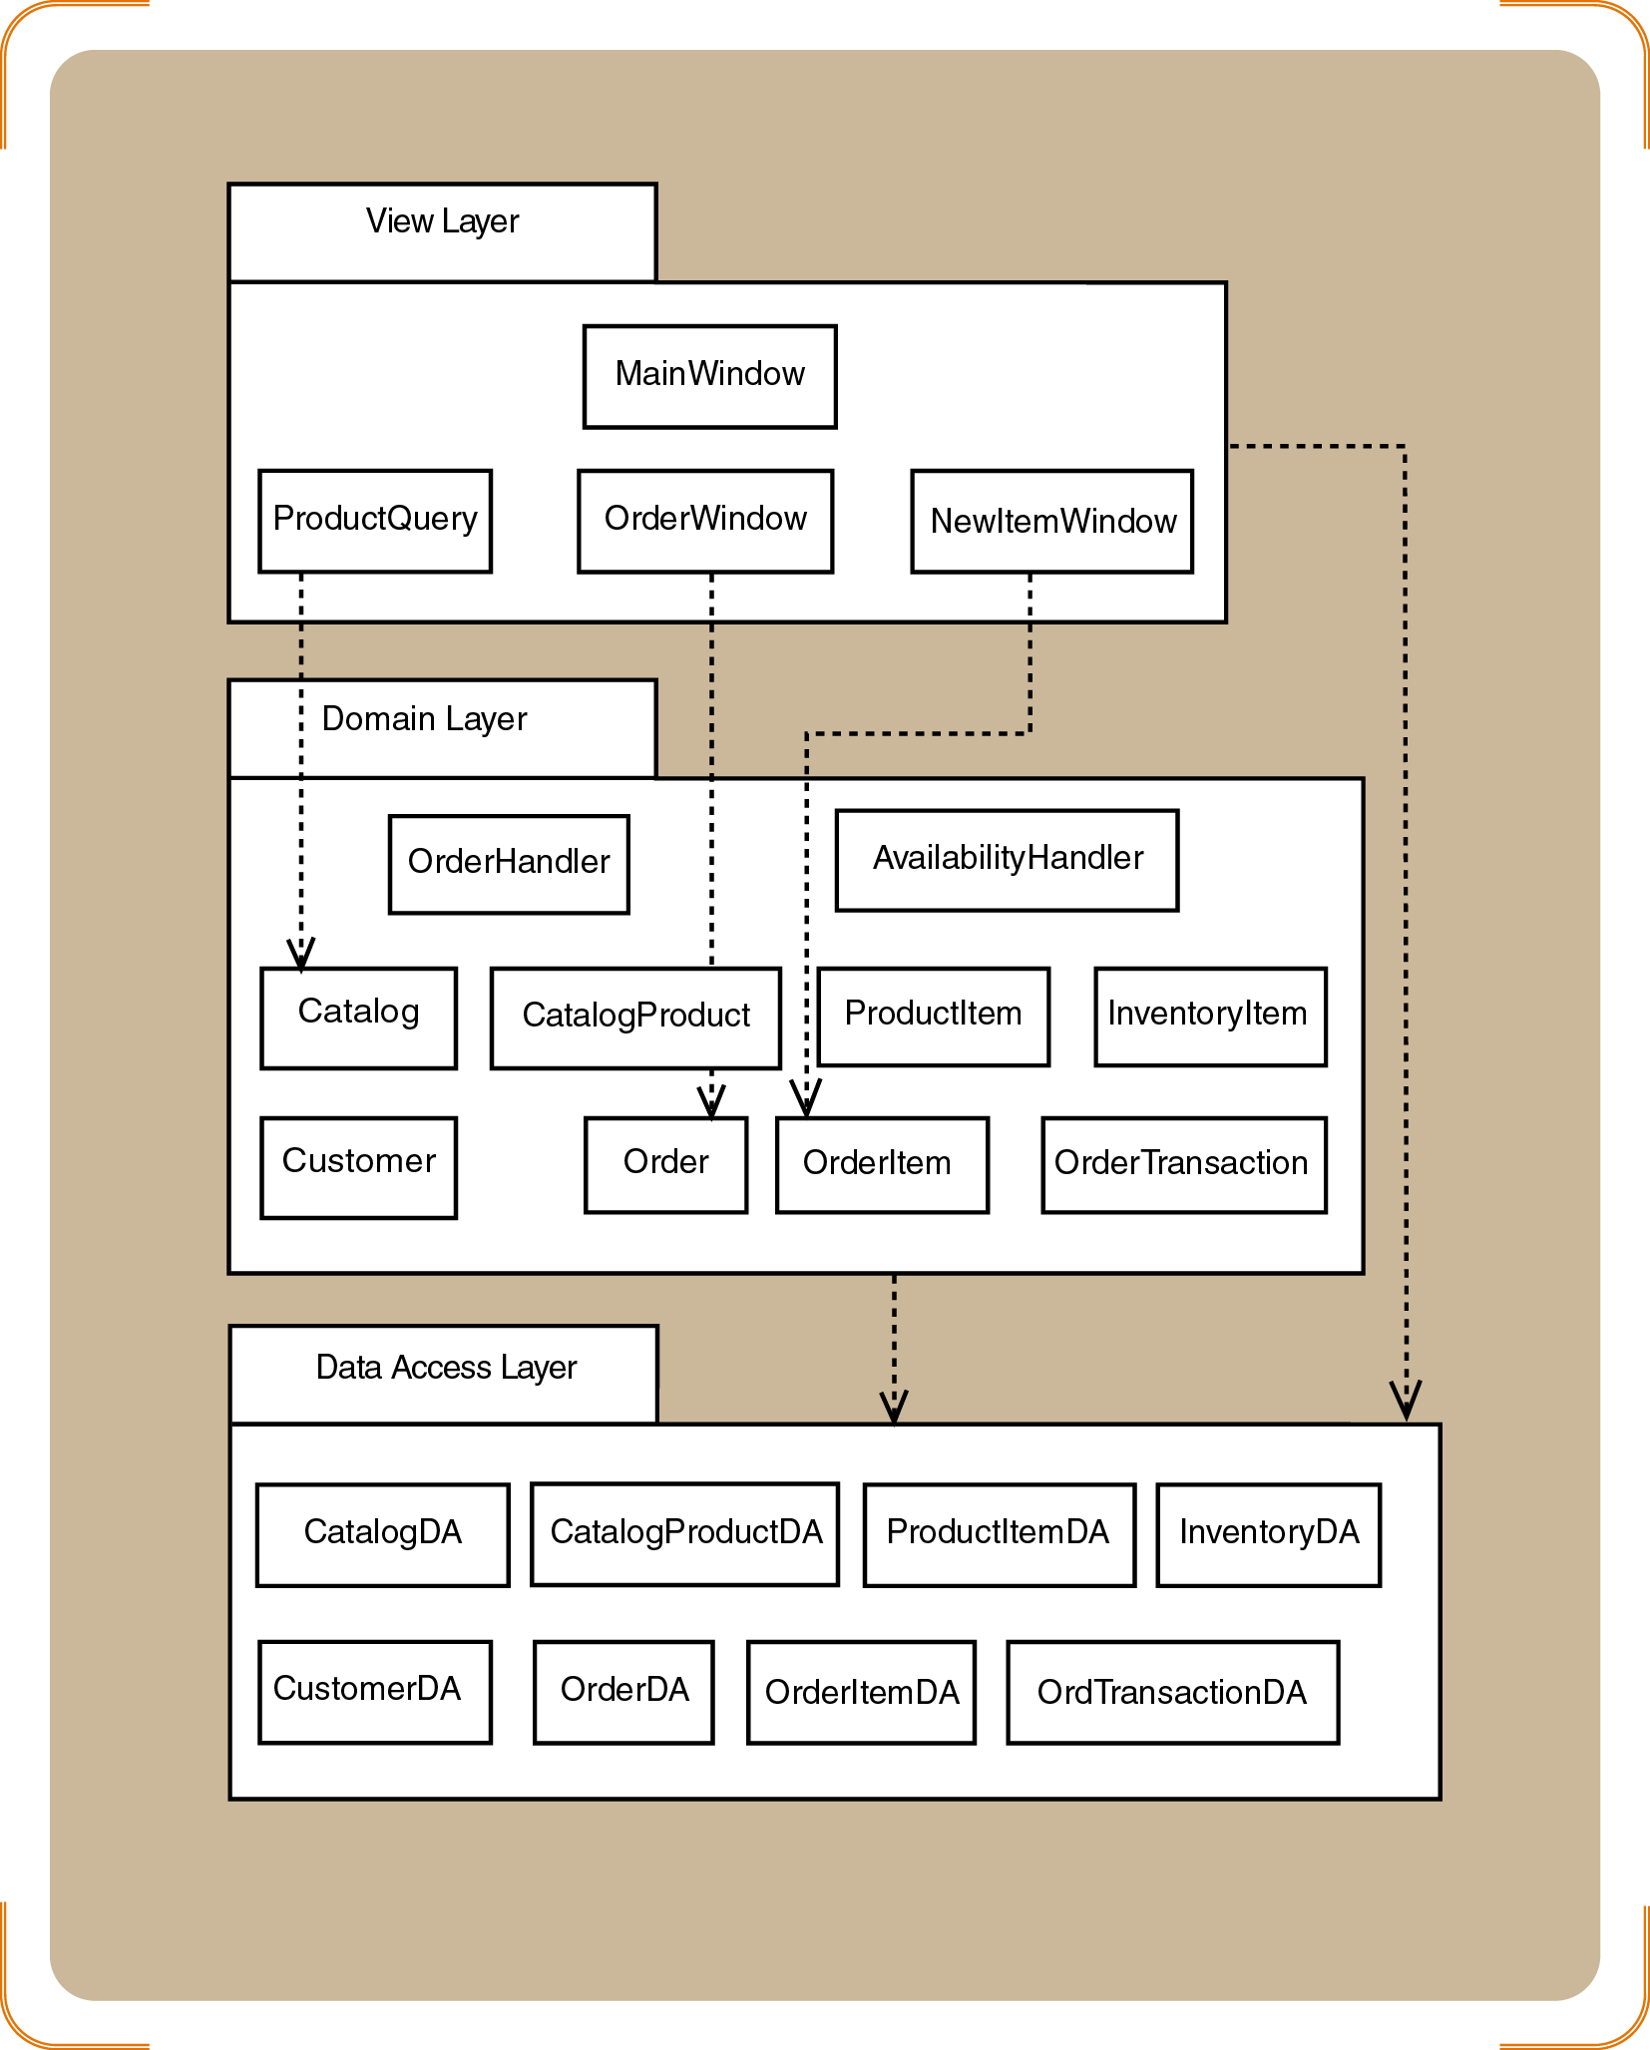
Example of Design Subsystems:
Combination of Layered (user interface, domain layer and data access layer), Subystems and Components
Note: Observe how package diagram and component diagram are included in the layered architectural style as discussed in Module 6

Slide 11
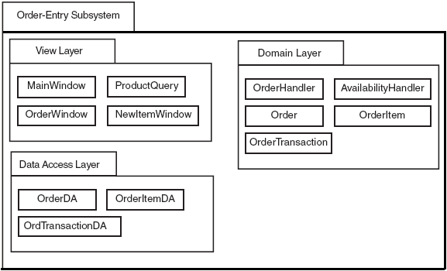
Example: Three-Layer Package Diagram for Order-Entry Subsystem
Note: Domain Layer also includes the controllers (OrderHandler and AvailabilityHandler)

Slide 12
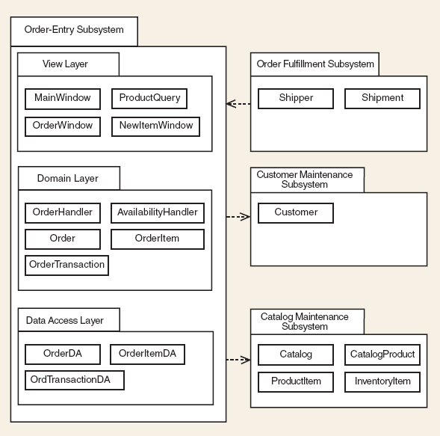
Example: Order Entry Subsystem and the interaction with other subsystems

